Slide 1

Hashing and file verification

Slide 2

Last week today!
So far we have looked at:
Using Visual Studio Code
Using the debugger
Using Path
The start of Hashing files

Slide 3
This week, today!
What is a hash?
What is a hashing algorithm?
How Hashes Establish Identity?
What is hashing used for?
Benefits of Hashing in Threat Hunting

Slide 4
What is a hash?
A hash function is any function that can be used to map data of arbitrary size to fixed-size values.
The values returned by a hash function are called hash values, hash codes, digests, or simply hashes.
The values are usually used to index a fixed-size table called a hash table.
Use of a hash function to index a hash table is called hashing or scatter storage addressing.
Notes:
One concept that you will meet time and time again in any discussion of cybersecurity is the concept of a hash. These long strings of apparently random numbers and letters are generated and used in several important ways. Some legacy AV solutions rely on them almost exclusively for detection purposes, but even though that is a rather limited and easily defeated way to detect modern malware, hashes still have great value for establishing identity and are used in many different ways. In this post, we’ll take a look at some of those as we explore what a hash is and how it works.

Slide 5
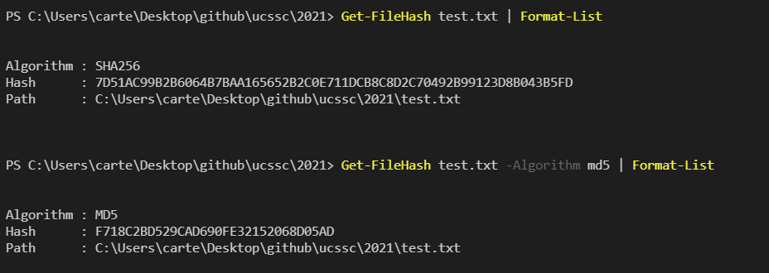
What is a hashing algorithm?
Hashes are the output of a hashing algorithm
These algorithms essentially aim to produce a unique, fixed-length string, for any given piece of data or “message”
Every file is data that can be represented in binary form, a hashing algorithm can a calculation on it and output a hash
Notes:
What is a hash and how does it work?
Hashes are the output of a hashing algorithm like MD5 (Message Digest 5) or SHA (Secure Hash Algorithm). These algorithms essentially aim to produce a unique, fixed-length string – the hash value, or “message digest” – for any given piece of data or “message”. As every file on a computer is, ultimately, just data that can be represented in binary form, a hashing algorithm can take that data and run a complex calculation on it and output a fixed-length string as the result of the calculation. The result is the file’s hash value or message digest.
To calculate a file’s hash in Windows 10, use PowerShell’s built in Get-FileHash cmdlet and feed it the path to a file whose hash value you want to produce. By default, it will use the SHA-2 256 algorithm
You can change to another algorithm by specifying it after the filepath with the -Algorithm switch. Passing the result to Format-List also gives a more reader-friendly output:

Slide 6
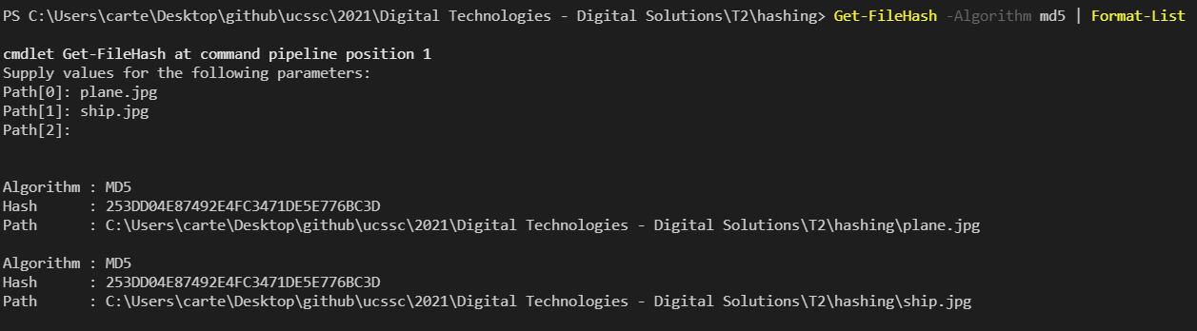
How Hashes Establish Identity?
Hashes can not be reversed
So, simply knowing the result of a file’s hash does not allow you to reconstruct the file’s contents
It does allow you to determine whether two files are identical or not without knowing their contents
Notes:
Hashes cannot be reversed, so simply knowing the result of a file’s hash from a hashing algorithm does not allow you to reconstruct the file’s contents. What it does allow you to do, however, is determine whether two files are identical or not without knowing anything about their contents.
For this reason, the idea that the result is unique is fundamental to the whole concept of hashes. If two different files could produce the same digest, we would have a “collision”, and we would not be able to use the hash as a reliable identifier for that file.
The possibility of producing a collision is small, but not unheard of, and is the reason why more secure algorithms like SHA-2 have replaced SHA-1 and MD5. For example, the contents of the following two files, ship.jpg and plane.jpg are clearly different, as a simple visual inspection shows, so they should produce different message digests.
However, when we calculate the value with MD5 we get a collision, falsely indicating that the files are identical. Here the output is from the command line on macOS using the Terminal.app, but you can see that the ship.jpg hash value is the same as we got from PowerShell earlier:
Let’s calculate the hash value with SHA-2 256. Now, we get a more accurate result indicating the files are indeed different as expected:

Slide 7
What is hashing used for?
Some legacy AV solutions rely entirely on hash values to determine if a file is malicious or not, without examining the file’s contents or behaviour
They do this by keeping an internal database of hash values belonging to known malware. On scanning a system, the AV engine calculates a hash value for each executable file on the user’s machine and tests to see if there is a match in its database.
Using hash values, researchers can reference malware samples and share them with others through malware repositories like VirusTotal, VirusBay, Malpedia and MalShare.
Notes:
Given a unique identifier for a file, we can use this information in a number of ways. Some legacy AV solutions rely entirely on hash values to determine if a file is malicious or not, without examining the file’s contents or behaviour. They do this by keeping an internal database of hash values belonging to known malware. On scanning a system, the AV engine calculates a hash value for each executable file on the user’s machine and tests to see if there is a match in its database.
This must have seemed like a neat solution in the early days of cyber security, but it’s not hard to see the flaws in relying on hash values given hindsight.
First, as the number of malware samples has exploded, keeping up a database of signatures has become a task that simply doesn’t scale. It has been estimated that there are upwards of 500,000 unique malware samples appearing every day. That’s very likely due in large part to malware authors realizing that they can fool AV engines that rely on hashes into not recognizing a sample very easily. All the attacker has to do is add an extra byte to the end of a file and it will produce a different hash.

Slide 8
When hashing isn’t so useful?
This is such a simple process that malware authors can automate the process such that the same URL will deliver the same malware to victims with a different hash every few seconds.
Second, the flaw in legacy AV has always been that detection requires foreknowledge of the threat, so by-design an anti-malware solution that relies on a database of known hash values is always one-step behind the next attack.
Notes:
This is such a simple process that malware authors can automate the process such that the same URL will deliver the same malware to victims with a different hash every few seconds.
Second, the flaw in legacy AV has always been that detection requires foreknowledge of the threat, so by-design an anti-malware solution that relies on a database of known hash values is always one-step behind the next attack.
The answer to that, of course, is a security solution that leverages behavioral AI and which takes a defense-in-depth approach.
However, that doesn’t mean hash values have no value! On the contrary, being able to identify a file uniquely still has important benefits. You will see hash values provided in digital signatures and certificates in many contexts such as code signing and SSL to help establish that a file, website or download is genuine.
Hash values are also a great aid to security researchers, SOC teams, malware hunters, and reverse engineers. One of the most common uses of hashes that you’ll see in many technical reports here on SentinelOne and elsewhere is to share Indicators of Compromise. Using hash values, researchers can reference malware samples and share them with others through malware repositories like VirusTotal, VirusBay, Malpedia and MalShare.

Slide 9
Benefits of Hashes in Threat hunting
A hash value is a result of a calculation (hash algorithm) that can be performed on a string of text, electronic file or entire hard drives contents.
The result is also referred to as a checksum, hash code or hashes.
Hash values are used to identify and filter duplicate files (i.e. email, attachments, and loose files) from an ESI collection or verify that a forensic image or clone was captured successfully.
Notes:
A hash value is a result of a calculation (hash algorithm) that can be performed on a string of text, electronic file or entire hard drives contents. The result is also referred to as a checksum, hash code or hashes. Hash values are used to identify and filter duplicate files (i.e. email, attachments, and loose files) from an ESI collection or verify that a forensic image or clone was captured successfully.
Each hashing algorithm uses a specific number of bytes to store a “ thumbprint” of the contents. The following is a list of hash values for the same text file. Regardless of the amount of data feed into a specific hash algorithm or checksum it will return the same number of characters. For example, an MD5 hash uses 32 characters for the thumbprint whether it’s a single character in a text file or an entire hard drive.

Slide 10
Why hash values are so widely used as a means to validate and compare content
Privileged Data – There would be obvious issues storing and providing multiple copies of the contents of a company’s files or entire hard drives data in a database to perform a byte comparison. Not to mention illegal images and videos (child pornography) would have to be stored and used in each system scan. These scenarios are unacceptable.
Speed – Comparing an indexed hash value versus what could be billions or trillions of bytes or source data is much quicker. Optimized hash engines (Pinpoint Harvester) can compare thousands of hash values in a second.
Security – Hashing data is a one-way trip. The original data can’t be recreated or reverse engineered from the hash value. This provides additional security that a person can’t determine the source data from the hash.
Notes:
) Privileged Data – There would be obvious issues storing and providing multiple copies of the contents of a company’s files or entire hard drives data in a database to perform a byte comparison. Not to mention illegal images and videos (child pornography) would have to be stored and used in each system scan. These scenarios are unacceptable.
2) Speed – Comparing an indexed hash value versus what could be billions or trillions of bytes or source data is much quicker. Optimized hash engines (Pinpoint Harvester) can compare thousands of hash values in a second.
3) Security – Hashing data is a one-way trip. The original data can’t be recreated or reverse engineered from the hash value. This provides additional security that a person can’t determine the source data from the hash.
The argument that data sources could be different and have the same hash value has raised a lot of concern. There are countless threads related to this issue on the litigation support and computer forensic forums. The bottom line is the only way to do an exact comparison of the original data is to store it everywhere you need to deduplicate or verify the information, however, as mentioned about this isn’t a practical alternative.

Slide 11
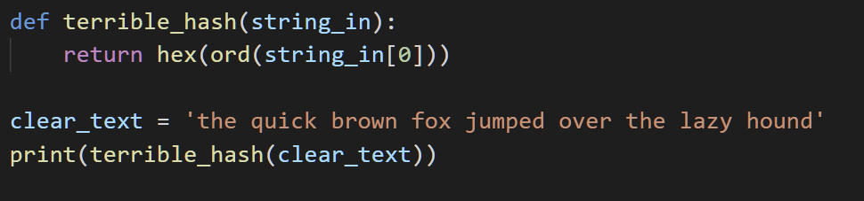
Terrible Implementation
Is this a suitable hashing algorithm for
Passwords?
Files?
Hard Drives?
Why | Why not?

Slide 12
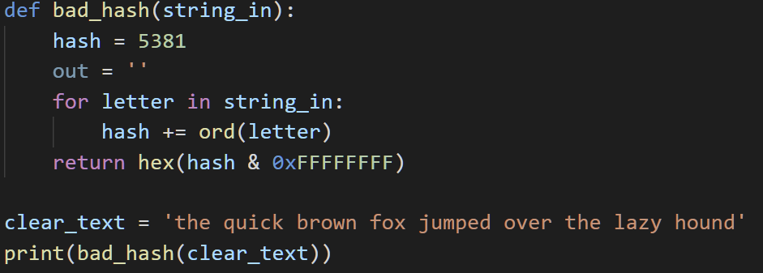
Bad Implementation
Is this a suitable hashing algorithm for
Passwords?
Files?
Hard Drives?
Why | Why not?

Slide 13
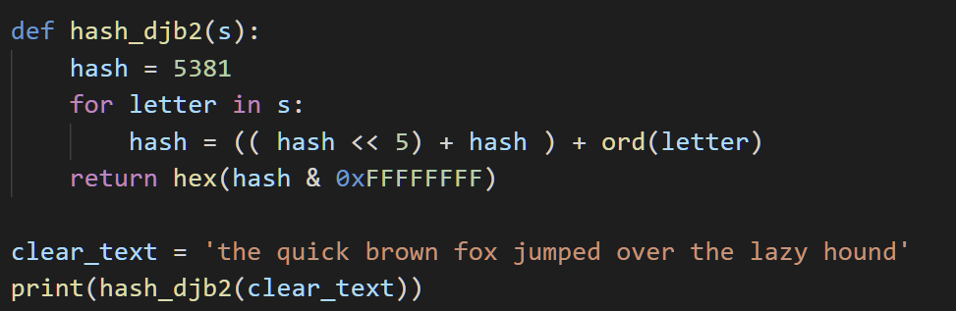
Meh implementation 3
<< is a special bit operator
It shifts the bits in a number to the left
0010 << 1 = 0100
0010 << 2 = 1000
hex() turns a number into a hexadecimal number

Slide 14
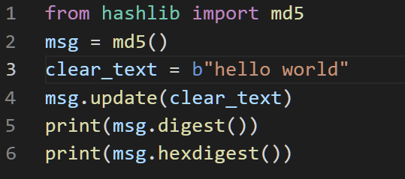
Python implementation

Slide 15
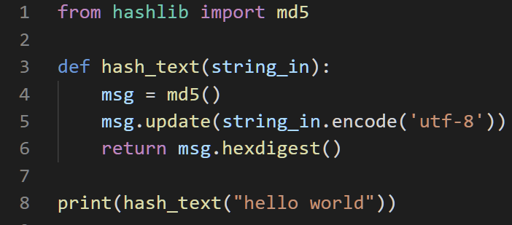
Python implementation 2

